Slide 1

Air Traffic Passenger Statistics
Final project. “She Goes Tech Python and Big data analytics”
Laura Žabinskienė
2023.05.17

Slide 2
Data
San Francisco International Airport Report on Monthly Passenger Traffic Statistics by Airline from website:
https://catalog.data.gov/organization/city-of-san-francisco
Period: 2005.07-2022.12
Data is self-reported by airlines and is only available at a monthly level
Data updated quarterly

Slide 3
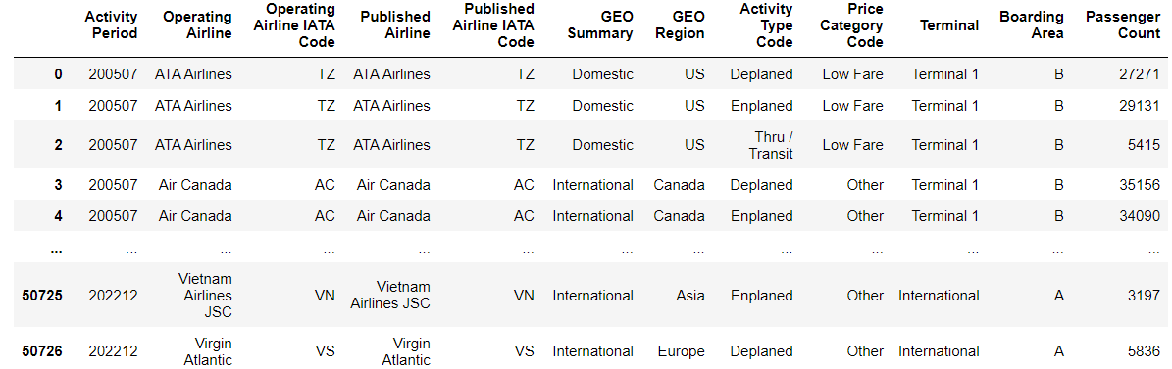
Data was read by pandas directly from the web with function pandas.read_csv
50730 rows × 12 columns

Slide 4
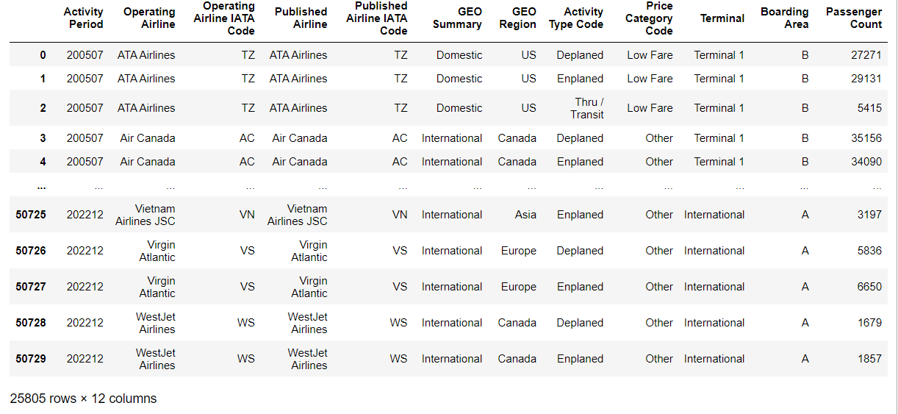
Data transformations
Removed duplicates

Slide 5
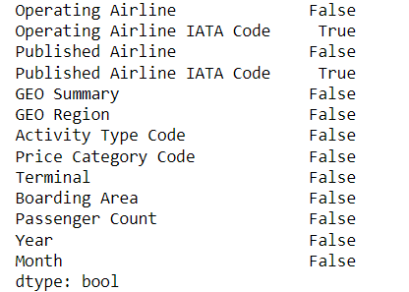
Data transformations
Detected missing values and filled NA/NaN values with zeros.

Slide 6
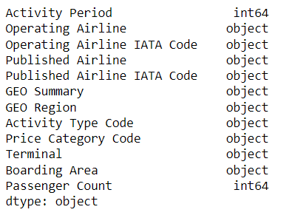
Data transformations
Checked data types

Slide 7
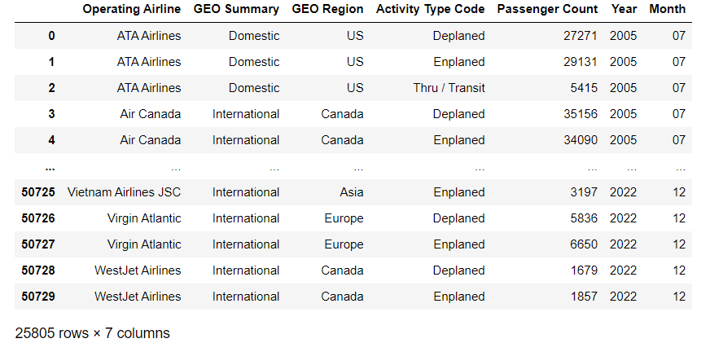
Data transformations
Splitted column ‘Activity period’ into two columns ‘Year’ and ‘Month’ and dropped not necessary columns

Slide 8
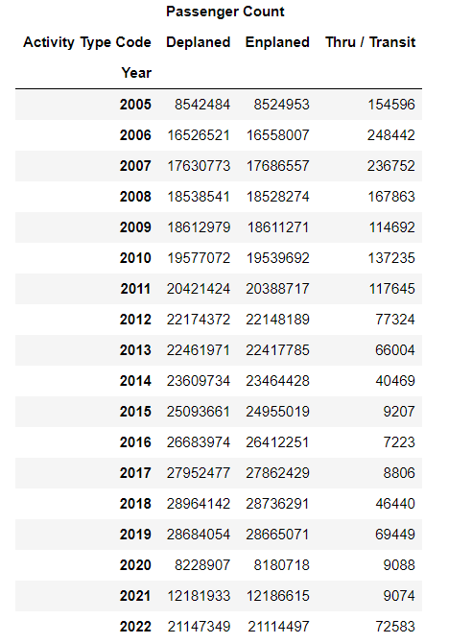
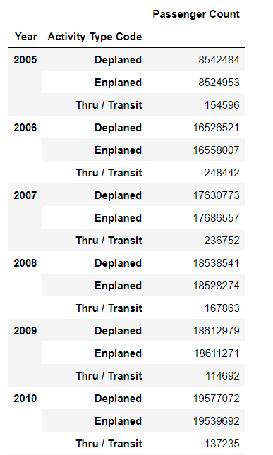
Data manipulations
Let’s check passenger’s activity during years sorted by ‘Deplaned’, ‘Enplaned’ and ‘Transit’.

Slide 9
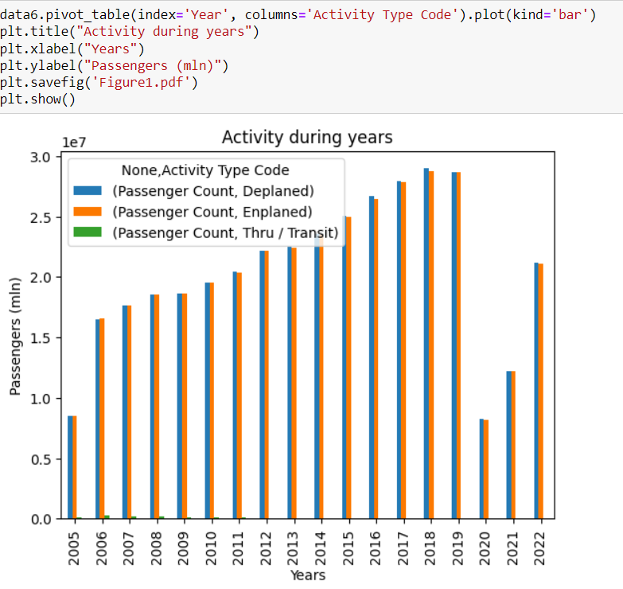
Data manipulations
Deplaned and enplaned passenger’s numbers are similar
Passenger activity significantly decreased in 2020 and 2021. We can assume that due to covid.

Slide 10
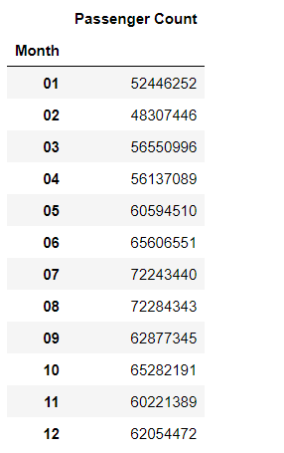
Data manipulations
Let’s check passenger's activity during months. Data was calculated by pivot table function.

Slide 11
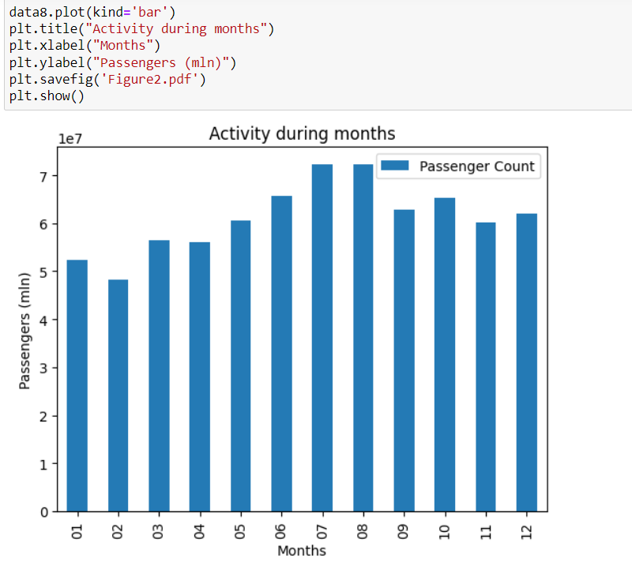
Data manipulations
The most active months for traveling were July and August

Slide 12
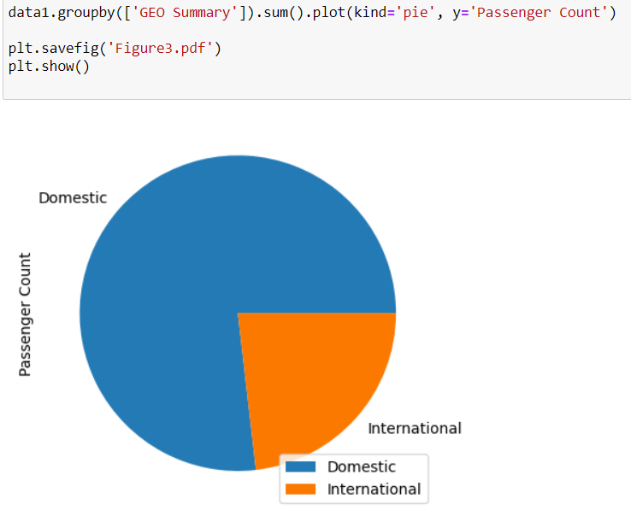
Data manipulations
Let’s check passenger’s activity between Domestic and International.
Results shows that Domestic flights take more activity at the SF airport.

Slide 13
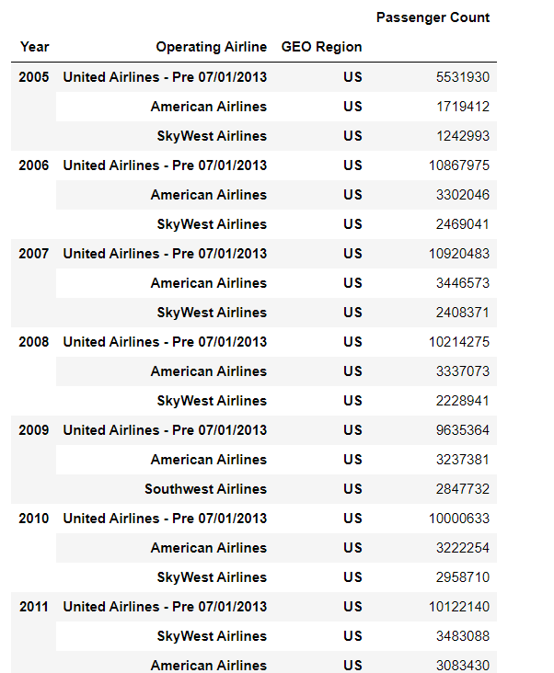
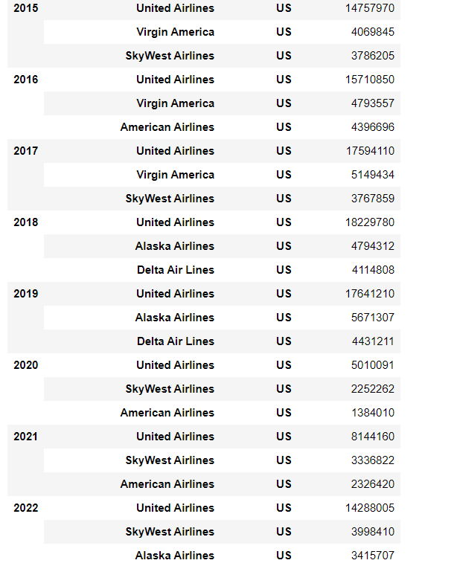
Data manipulations
Let’s check domestic airlines activity using pivot_table, sort_values and groupby functions.

Slide 14
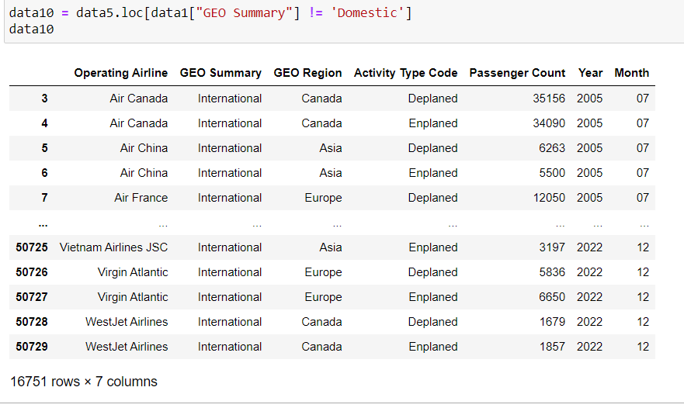
Data manipulations
Let’s check international airlines activity.

Slide 15
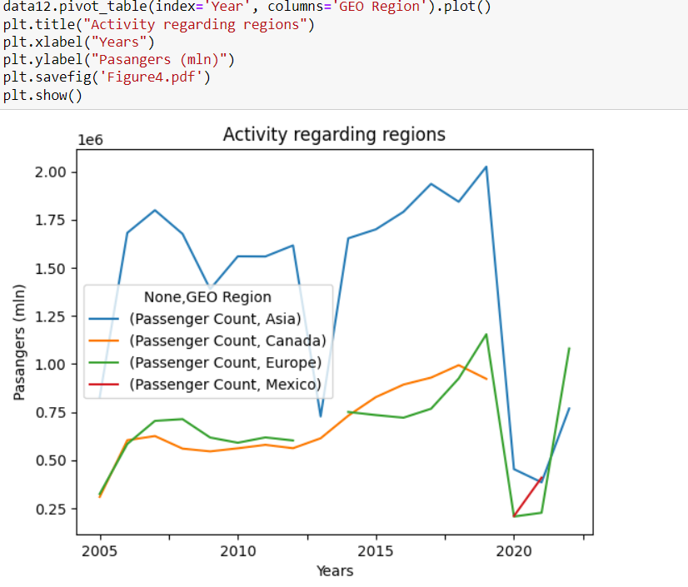
Data manipulations
The figure shows the international airlines activity regarding regions during years.

Slide 16
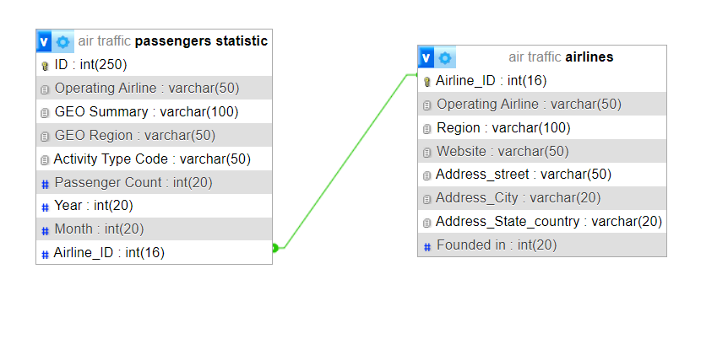
Database using MySQL
1. Structure of tables was created in MySQL.

Slide 17
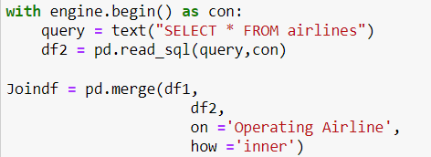
Database using MySQL
2. Table “airlines” was read with pandas from excel and transferred to MySQL using mysql.connector and pymysql.
3. For table “passengers statistic” was added additional column “Airline_ID” with merge function from table “airines” and dropped not necessary columns. Than it was transferred to MYSQL.

Slide 18
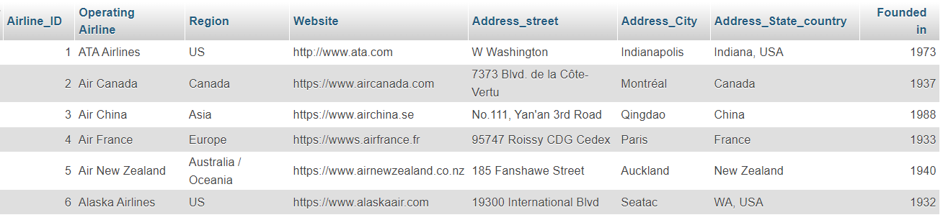
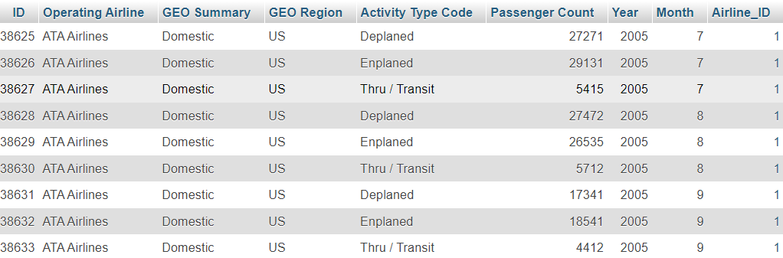
Database using MySQL
4. Both data tables were successfully stored to MySQL database.

Slide 19
Thanks!

